Slide 1
L4/5- Group 8
Thomas Wenman – Group Manager/ Designer
Bailey Keeble – Designer
Ethan Ward - Programmer

Slide 2
Logline

Slide 3
Art style

Slide 4
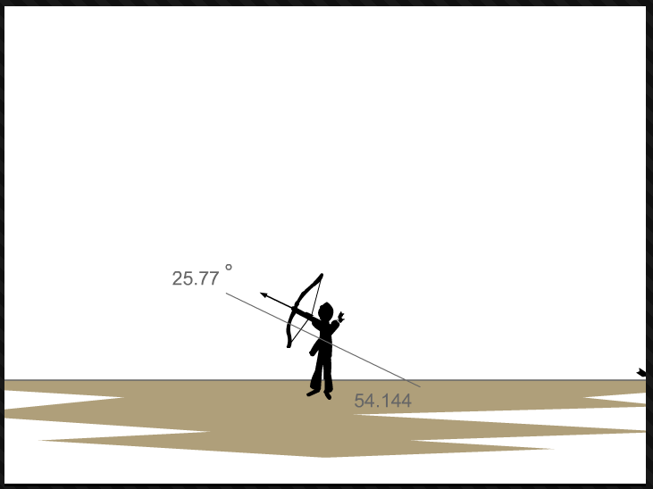
First mechanic: Shooting/Launch
Bowman 2 – Shows the player the degrees/angle of where the player will shoot
Only shows the player.
Camera follows the arrow
Takes time to master as remembering where to shoot can be a challenge.

